Slide 1
Technical Report writing
Sufia Azim
Assistant Professor
UPTTI,Kanpur

Slide 2
Definition of Report?
A report is a formal document written for a specific audience to meet a specific need. It may contain facts of a situation, project, or process; an analysis and interpretation of data, events, and records: inferences or conclusions drawn from objective data or suggestions and recommendations.
Reports normally move in an upward direction and are used to communicate to the senior levels in an organisations.

Slide 3
Functions of Report
It provides information in a scientific way.
Helps in planning new ventures.
Helps in evaluating the performance of employee for promotion.
Helps in keeping record for feedback.

Slide 4
Use of Reports
Presenting data.
Describing problems and suggesting solutions.
Discussing and analysing data.
Recording events and happenings.
Analysing a situation or a condition.
Giving feedback, suggestions, or recommendations.

Slide 5
Steps in writing Report
Analyse the problem
Determine the scope of report
Consider the audience/reader
Gather information
Analyse the information
Prepare the report

Slide 6
Structure of a Report
Front matter
Main Body
Back Matter

Slide 7
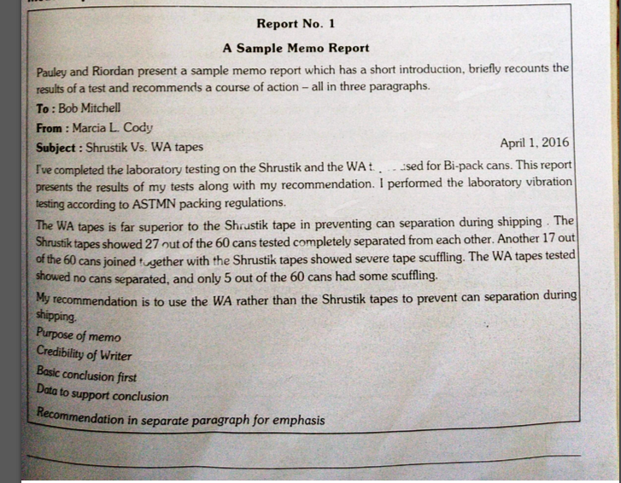
Samples of Report

Slide 8
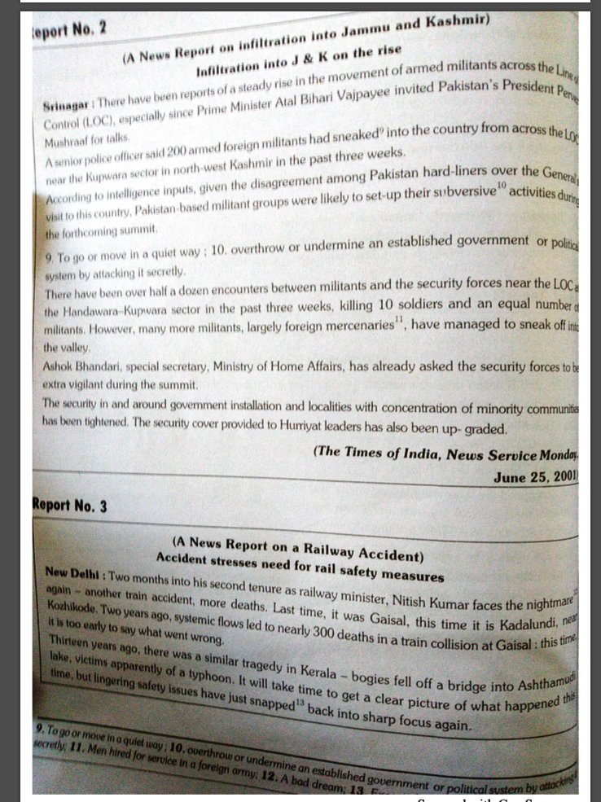
Sample

